Slide 1
CSE302: Computer Networks Project
Simulation and Analysis of Dynamic routing
over Static Routing
Presented By
Naguru Naveen Kumar Reddy
124003192
CSE Core
1

Slide 2
Points discussed
Aim & Objective
Problem Statement
Solution
Routing and Routing protocols
Static vs Dynamic
System Configuration : Software, Network type, Protocols used
Work Done
Sample I/O (screen shot)
Proposed Work Flow and Methodology
References

Slide 3
AIM & OBJECTIVES
The aim of the project is implementing the Dynamic, Static routing protocols in Wired Network to simulate the application topology and real time network in NS2 and Cisco Packet Tracer environment.
Objective 1: Understanding Dynamic (DV, LS, Ospf), Static routing protocols
Objective 2: Applying routing protocol network concepts
Objective 3: Creating simulating scenario
Objective 4: To be able to find the best routing protocol for a given network type

Slide 4

Problem Statement & Solution
Problem statements is:
Each routing protocol has a distinct level of performance. Each of them has a unique architecture, adaptability, route processing latency, and convergence capabilities in terms of the performance of the routing protocol. It is critical to choose the best routing protocol for a specific network because every set of routing protocols has advantages and disadvantages of their own for a given network.
The proposed solution is :
Different routing protocols are explained .Two important routing protocols simulated and analyzed . Dynamic routing is used to counter the static routing and the key metrics like throughput, Packet delivery , Packet loss etc., are analyzed to have the better understanding. Proofs were given to specify the best routing protocol for a given network.

Slide 5
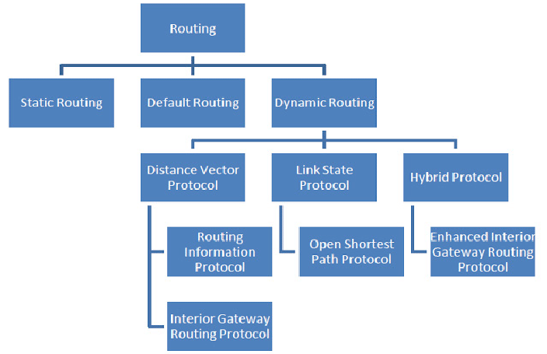
Routing and Routing Protocols

Slide 6
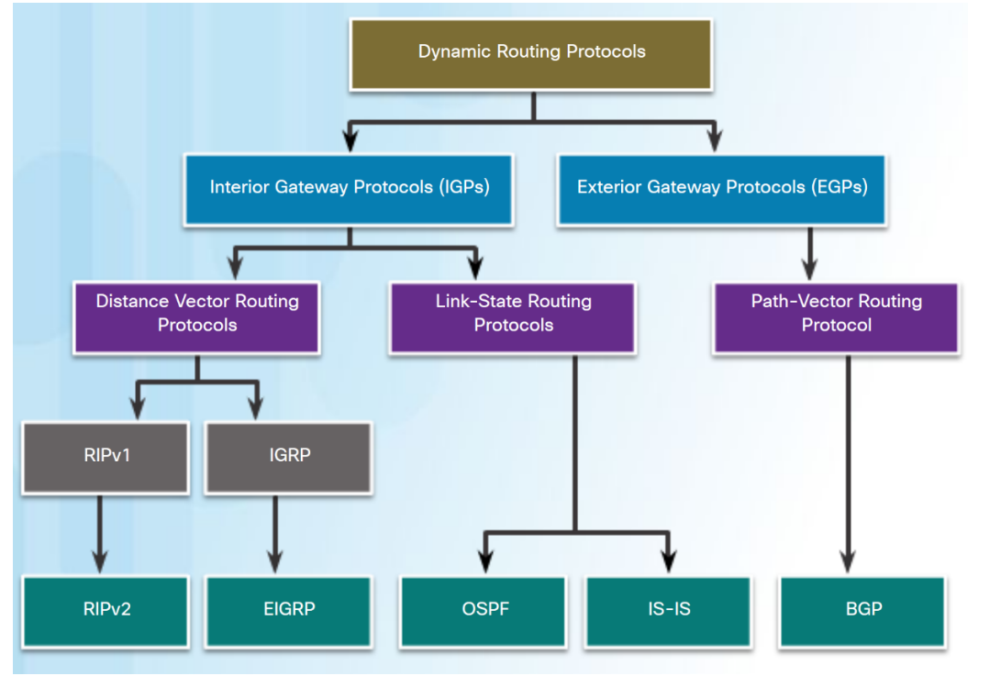
Dynamic Routing Protocols 6

Slide 7
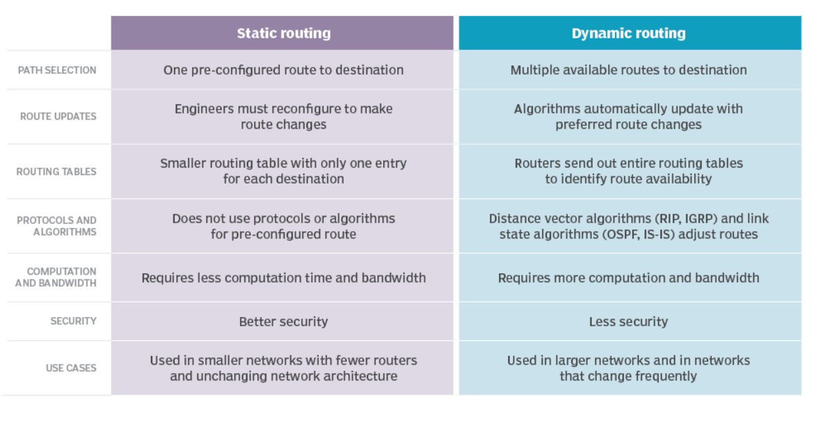
Dynamic vs Static Routing

Slide 8
System configuration
Node topology
Software used: NS2
Network : Wired
Protocol: DV, LS, Static
Network Simulation
Software used: Cisco Packet Tracer
Network: Wired
Protocol: Ospf,static

Slide 9
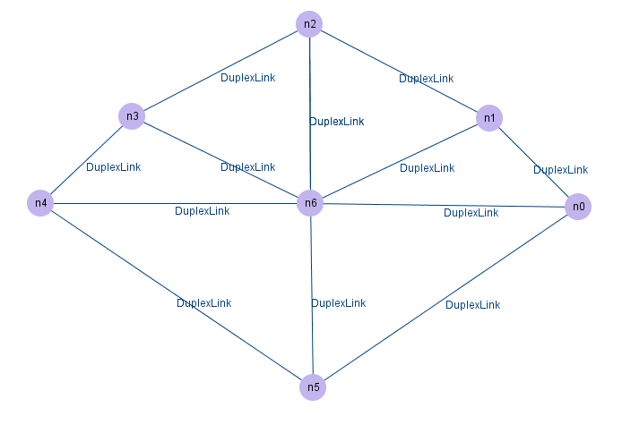
Network Architecture NS2

Slide 10
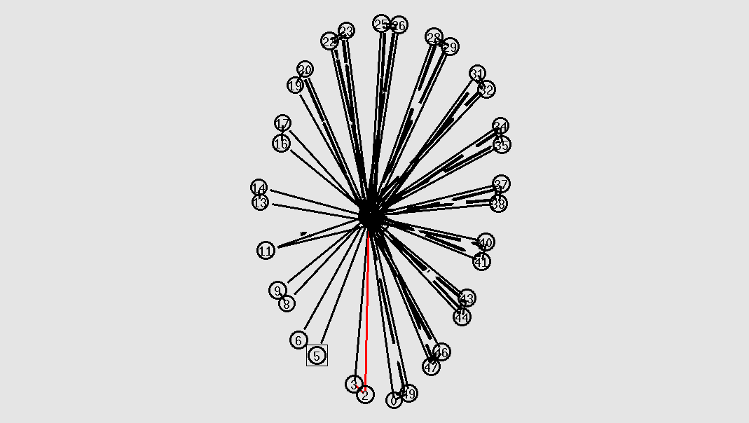
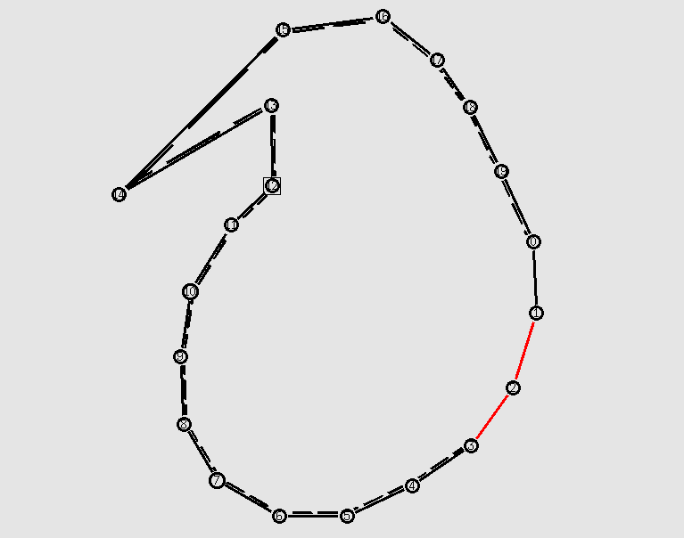
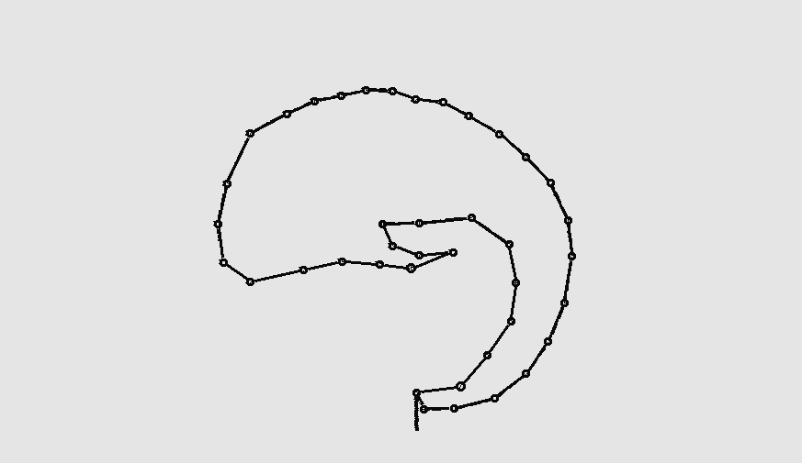
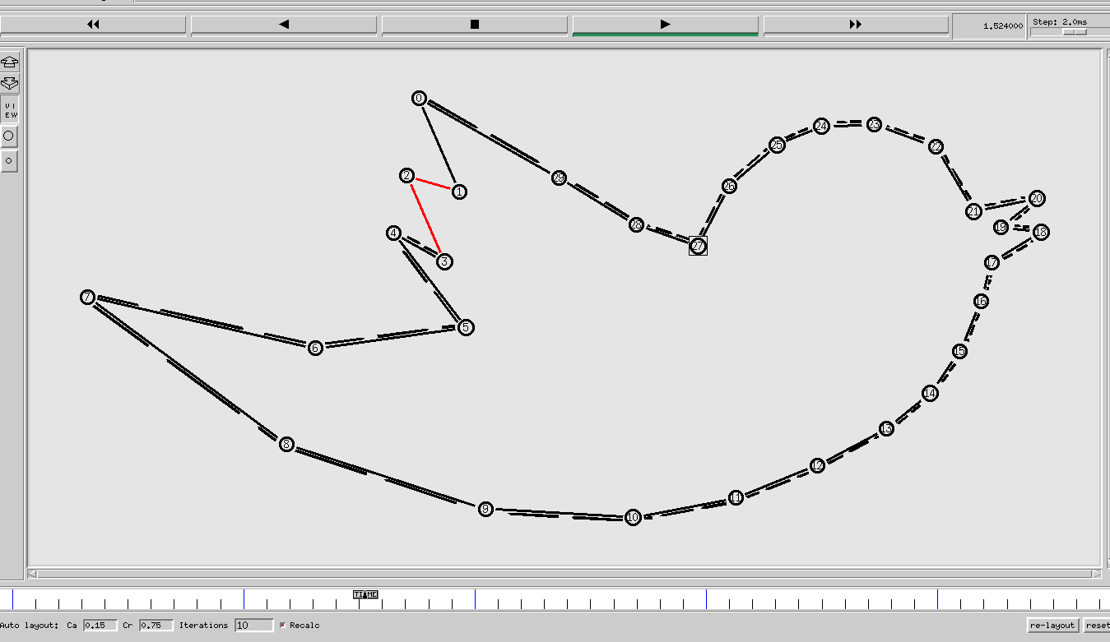
Network Architecture NS2

Slide 11
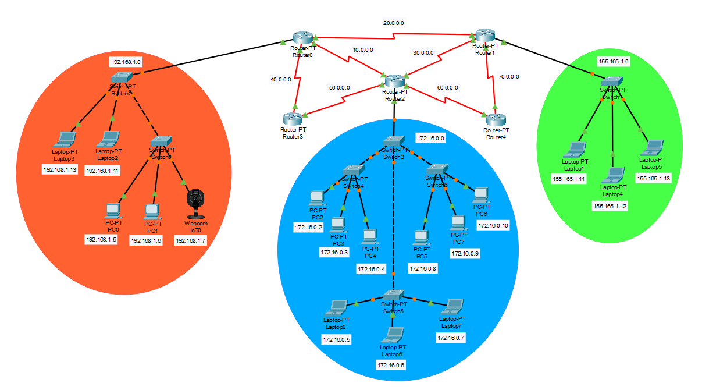
Network Architecture CPT

Slide 12
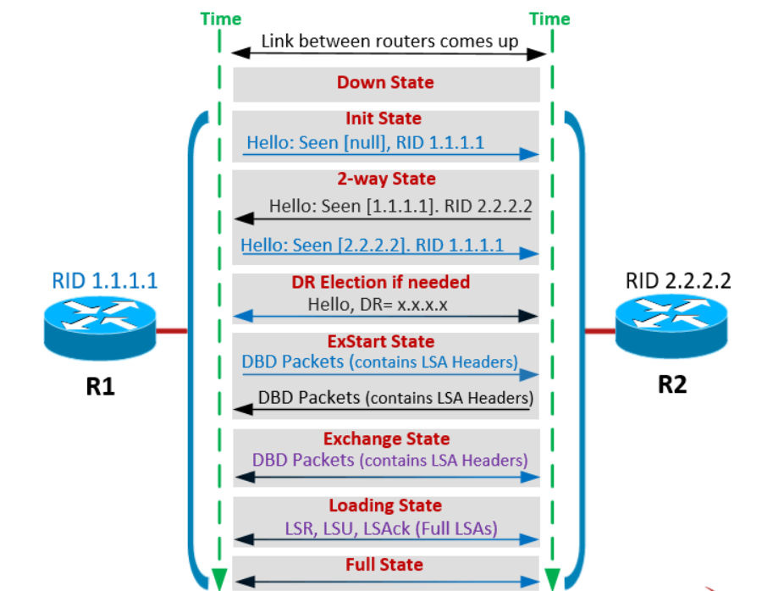
Proposed Protocol Description

Slide 13
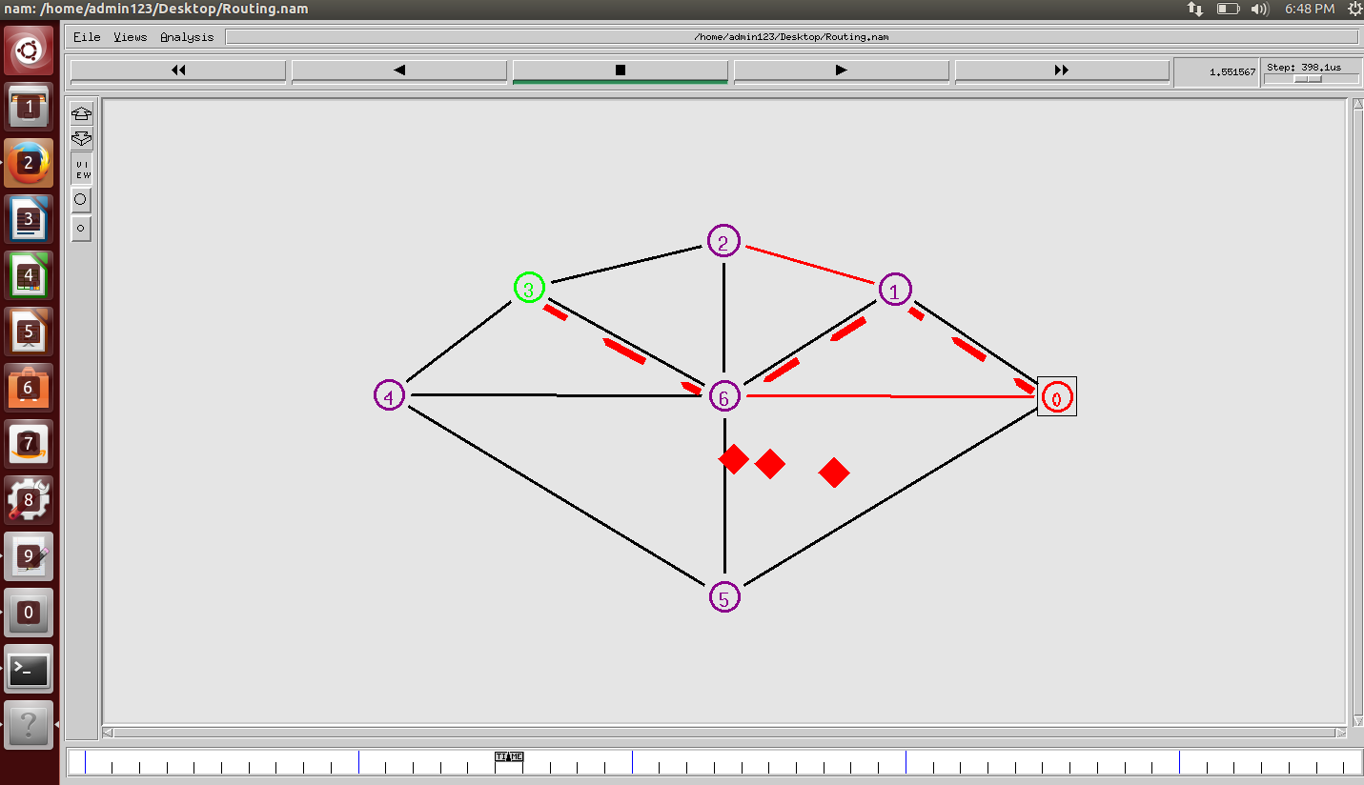
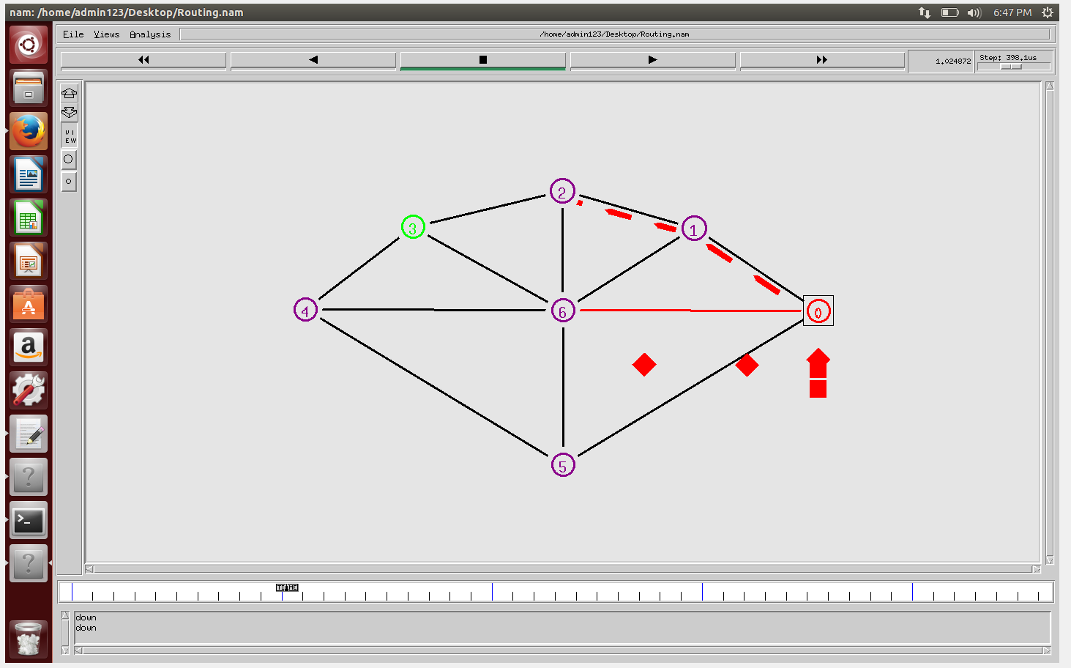
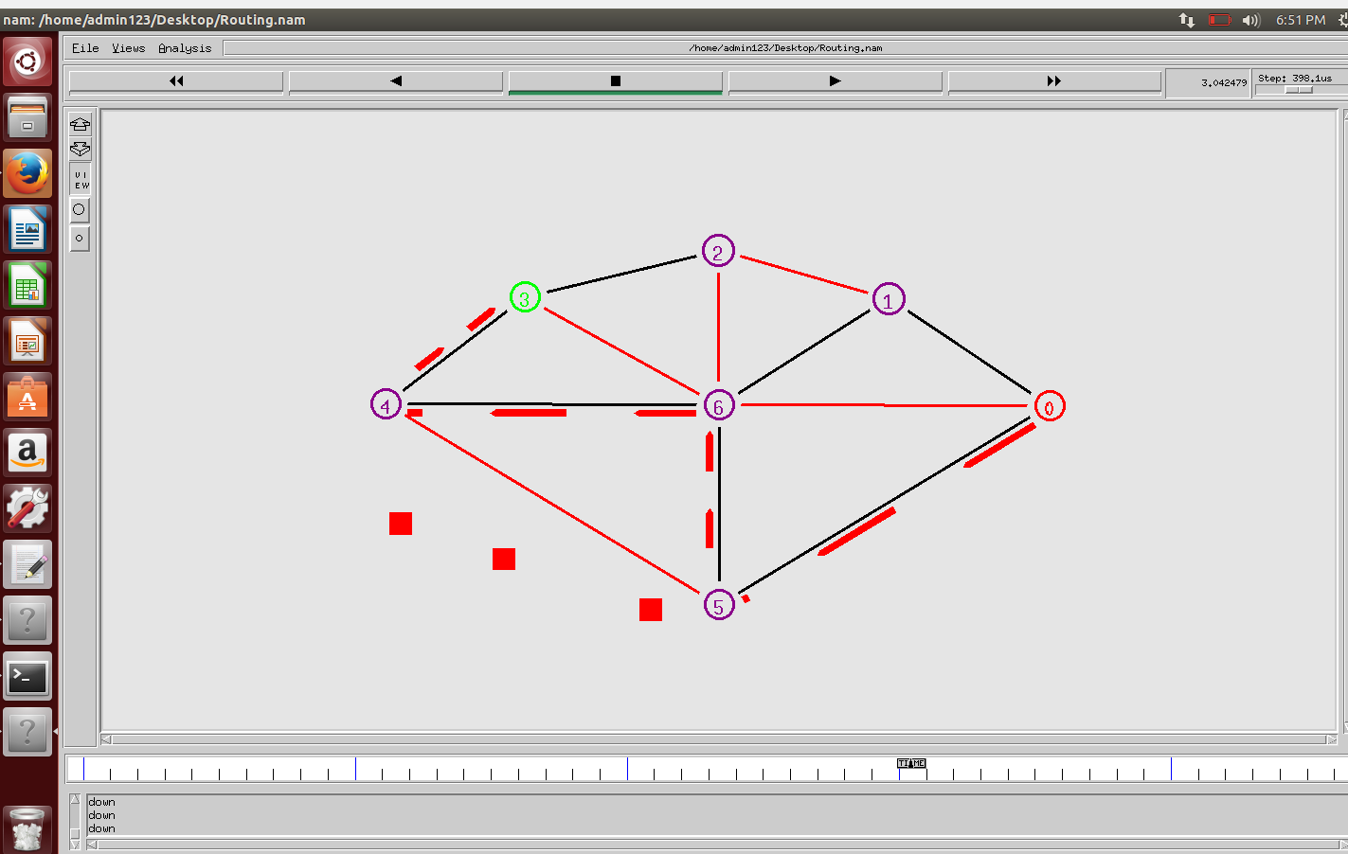
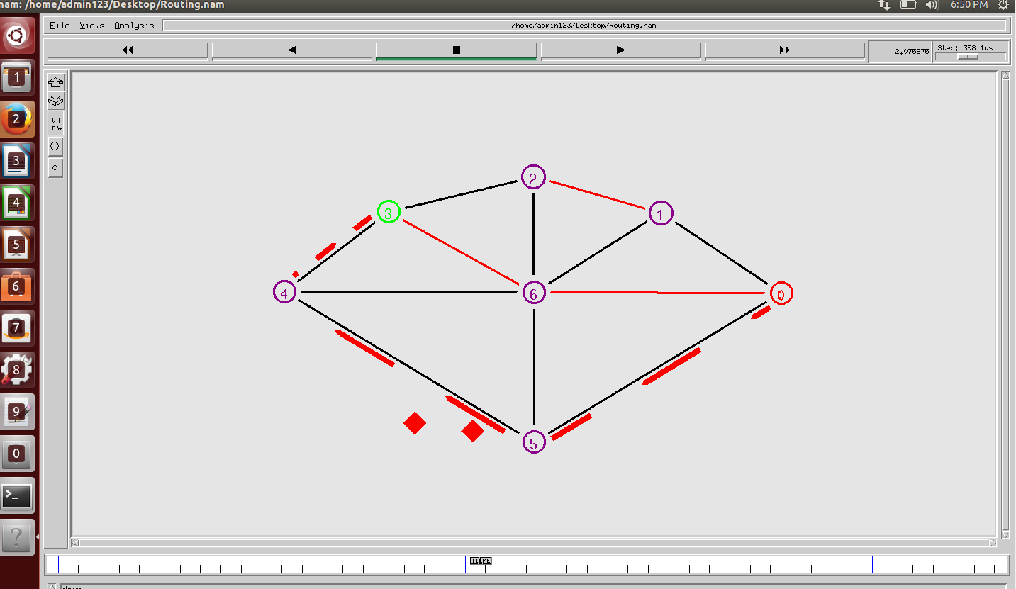
Sample I/O screen shots

Slide 14
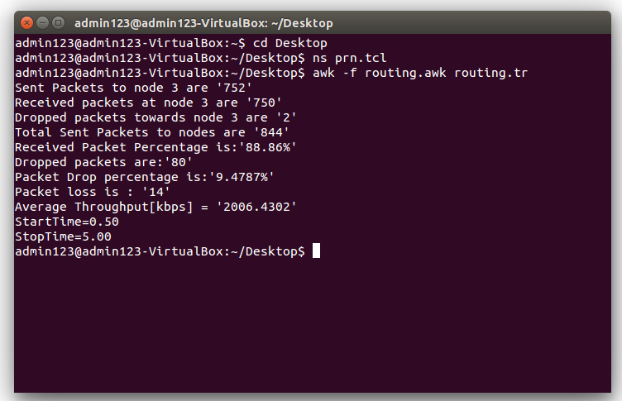
Analysis of Dynamic Topology

Slide 15
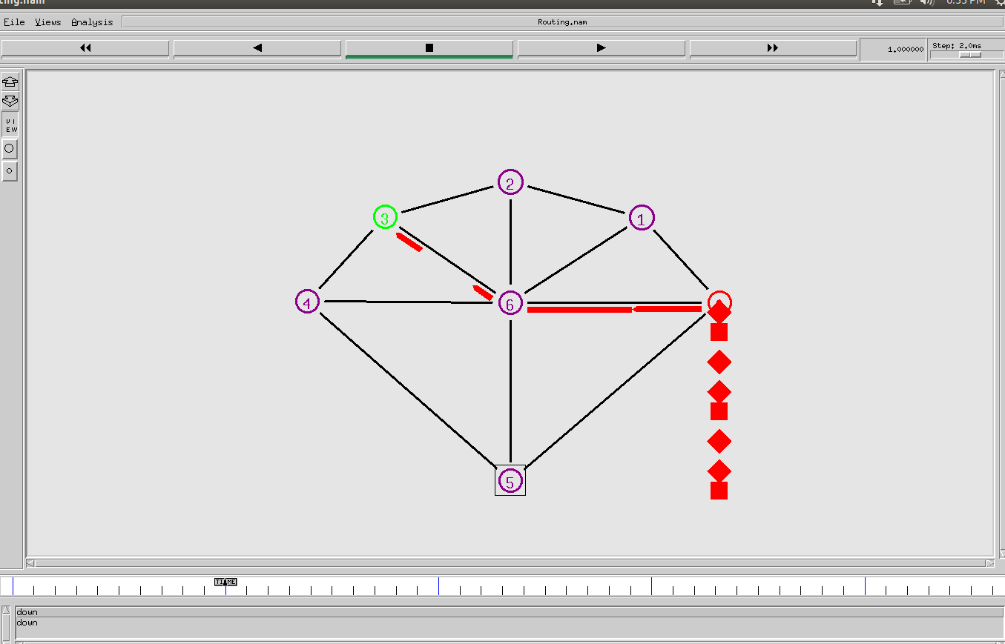
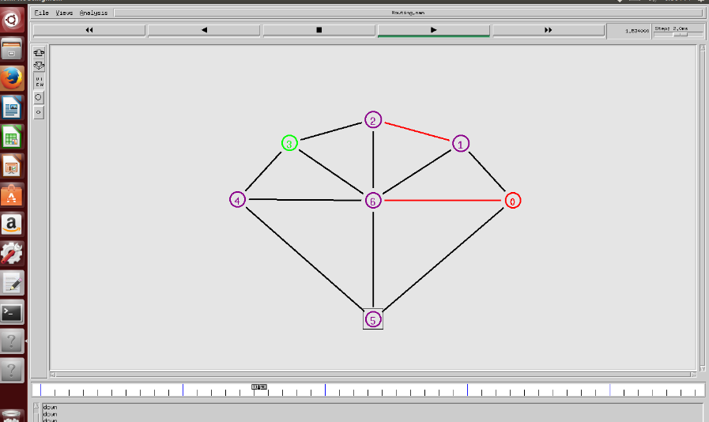
Static Topology

Slide 16
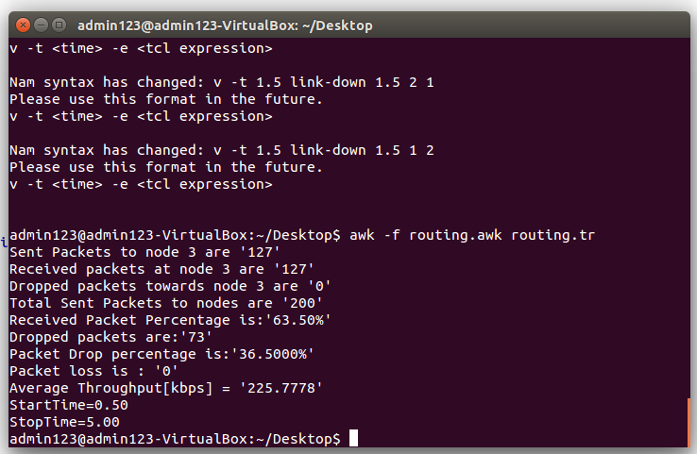
Analysis of Static Topology

Slide 17
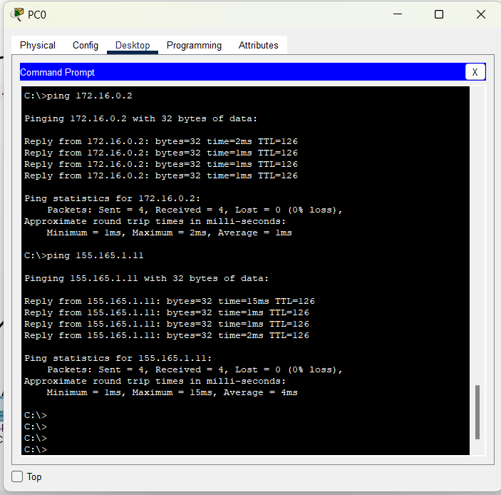
Ping analysis Dynamic

Slide 18
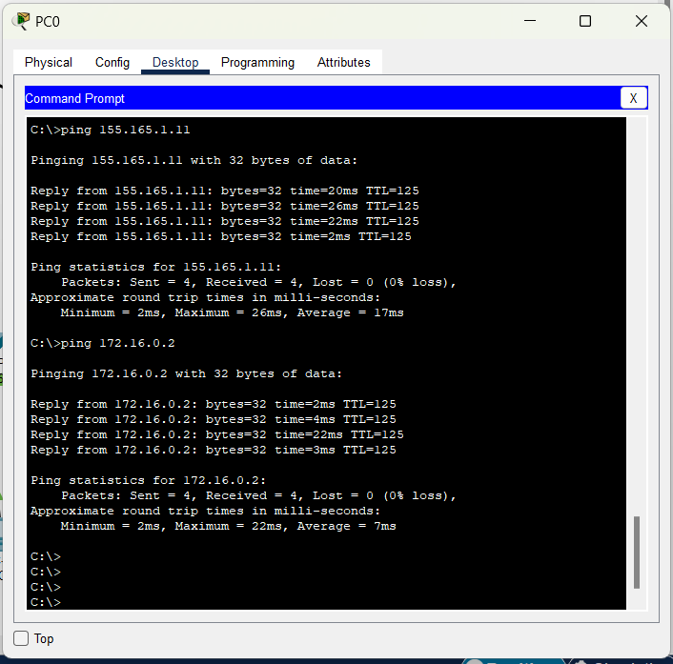
Ping analysis Dynamic

Slide 19
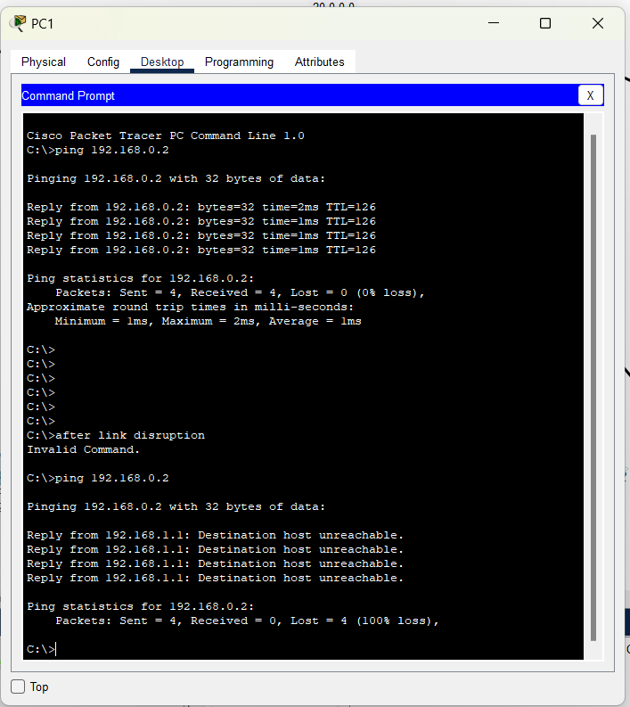
Ping analysis Static

Slide 20
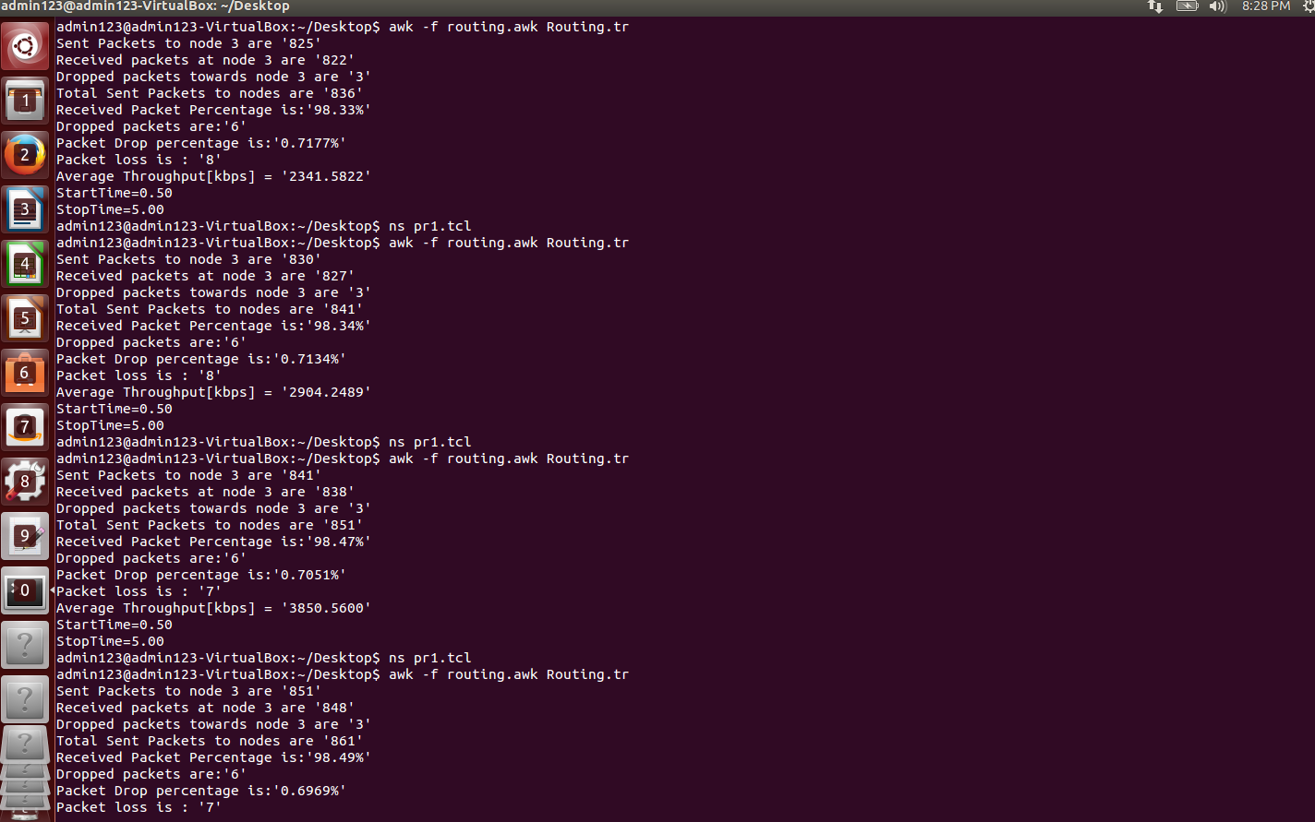
Dynamic Routing variable nodes

Slide 21
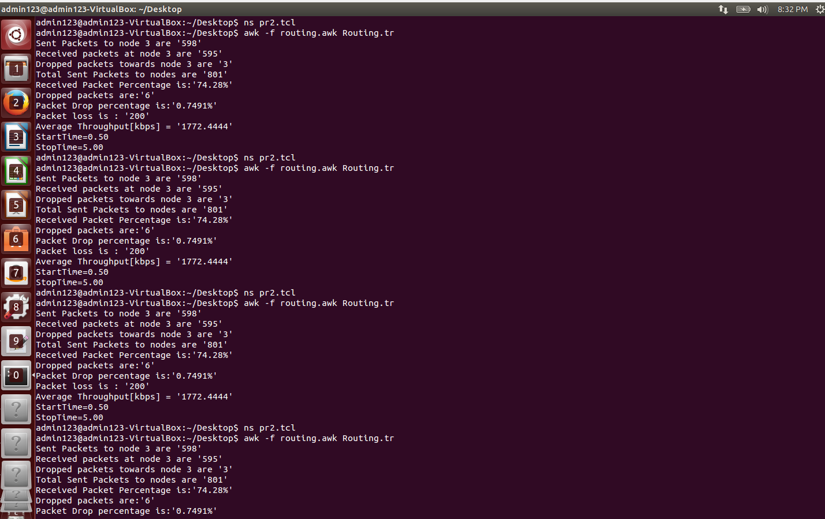
Static Routing variable nodes

Slide 22
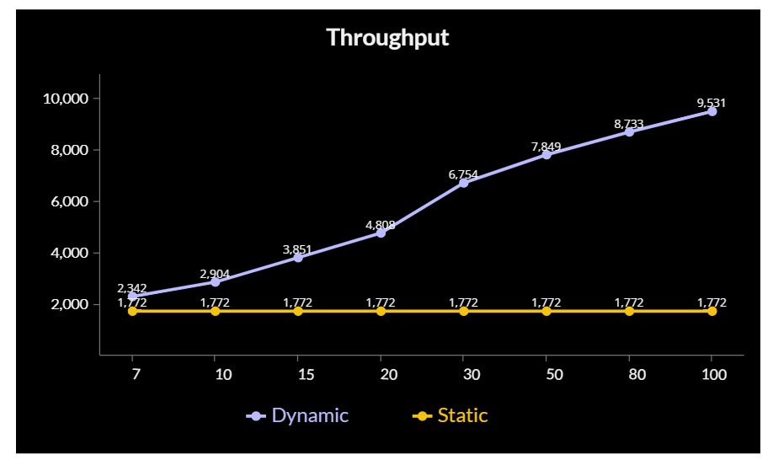
Metric Analysis

Slide 23
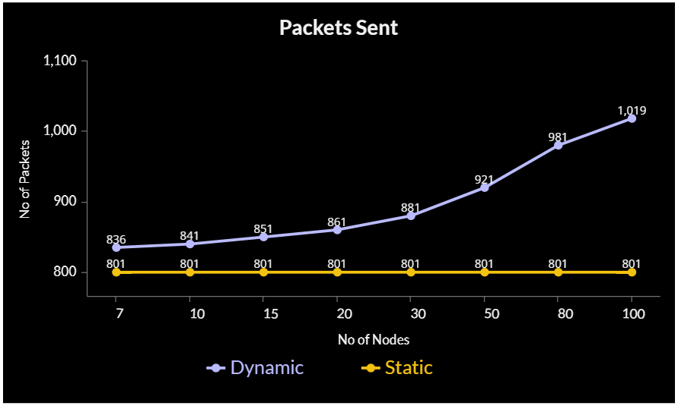
Metric Analysis

Slide 24
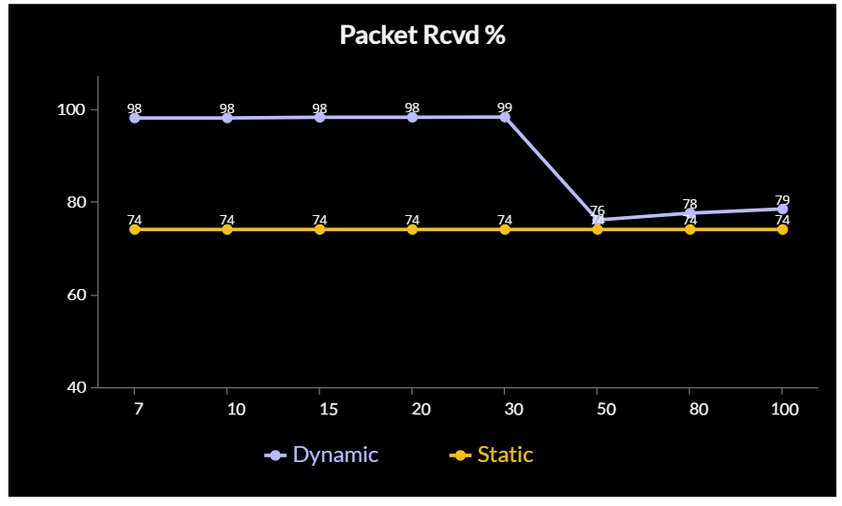
Metric Analysis

Slide 25
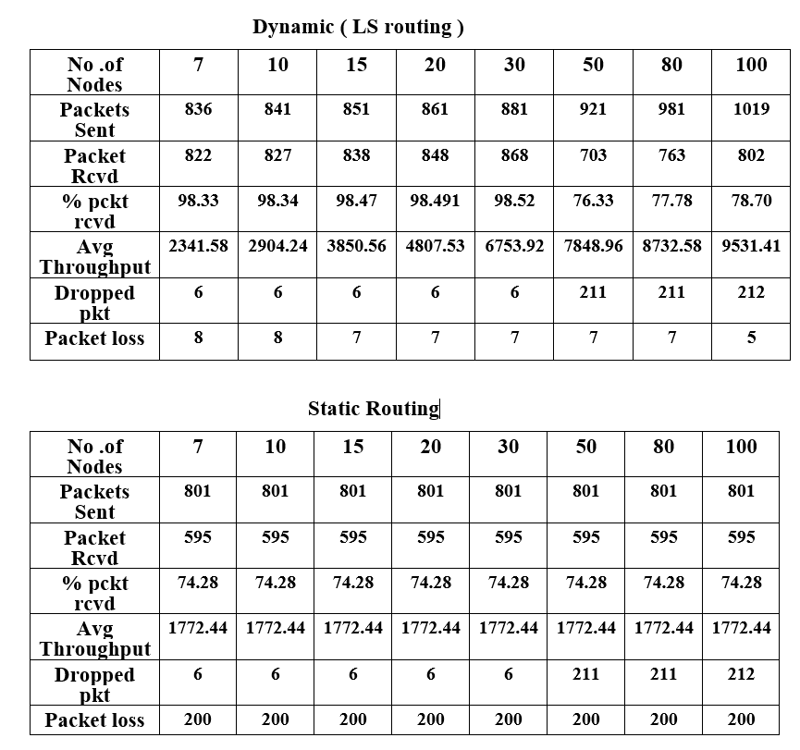
Static vs Dynamic Metrics

Slide 26
Proposed Work Flow and Methodology
NS2
Taken the Static and dynamic routing protocols as base of my project analysis.
Selected DV,LS,OSPF routing protocols as my simulation protocols.
Used Ns2 and developed a tcl code of topology to analyze the routing protocols with and without link description.
Developed an code for an variable node topology in NS2.
Developed an awk code to analyze the key metrics like throughput, packet loss, packet rcvd
Simulated the dynamic and static topologies and made the required analysis and was able to come to a conclusion.
Plotted graphs on the key metrics that I have analyzed.

Slide 27
Proposed Work Flow and Methodology
Cisco Packet Tracer
Procedure followed to create the Ospf network :
1. Configure end devices and connect them to switch
2. Connect the switch to a router, say router 0 and following the same with other routers and end devices.
3. Configure the end devices and their corresponding with router with appropriate IP address that resemble that they belong to same Site .
4. Let the network be named as Home, and the router as router 0.
5. Repeat the above steps and name the network as Branch office .
6. Configure a router, naming it as Internet Service Provider (ISP), with unique IP address that don’t resemble the previous routers’ IP address
7. Connect the routers with IP address, that shall separate the outgoing path from the home and branch office networks’ IP addresses.
8. Further, connect a similar network with couple of networks, naming them public area-1, public area-2, public area-3 etc.
9. Configure the end devices’ default gateway address as IP address of their corresponding site router.
10. Configure the OSPF/Static protocol in routers that shall identify the other peer’s IP address .
The same procedure followed to create the static network but has manually entered the routing measures for each router in the network .

Slide 28
References
15
https://www.techtarget.com/searchnetworking/definition/router
https://www.oreilly.com/library/view/junos-enterprise-routing/9780596514426/pr02s02.html#:~:text=At%20the%20simplest%20level%2C%20routing,into%20a%20hierarchical%20network%20structure.
https://www.tutorialspoint.com/what-are-static-routing-algorithms-in-computer-networks
https://www.hitechwhizz.com/2020/11/5-advantages-and-disadvantages-drawbacks-benefits-of-static-routing.html
https://www.geeksforgeeks.org
https://www.scaler.com/topics/computer-network
https://www.firewall.cx/networking-topics/routing/ospf-routing-protocol/1110-ospf-operation-basic-advanced-concepts-ospf-areas-roles-theory-overview.html
https://www.subnet-calculator.com/subnet.php?net_class=C
https://www.wikipedia.org/
https://www.cisco.com/c/en_in/index.html

Slide 29
17
Thank You

